Slide 1
Gamifying your course
Colin Simpson - @gamerlearner
Please go to http://kahoot.it (on any device) and sign in using the PIN 93397
Choose a creative Nickname (not just your name) and join the game
We will begin shortly

Slide 2
How do you feel?
We’ll try that game again in a little while.
What is gamification?
What makes a game?
What does gamification look like in education?
Why should I gamify?
How can I gamify?

Slide 3
Gamification is all around us

Slide 4
Gamification is all around us

Slide 5
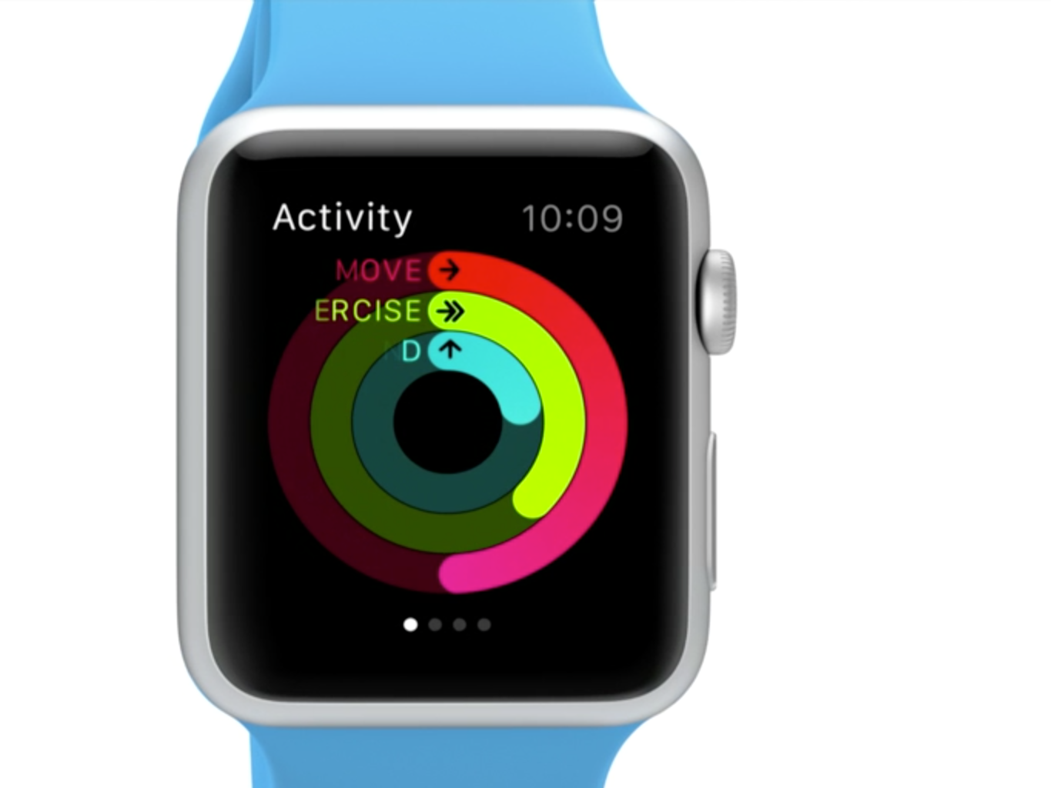
Gamification is all around us
http://static.businessinsider.com/image/540f4950eab8eaa25e65a624/image.jpg http://s1.ibtimes.com/sites/www.ibtimes.com/files/styles/v2_article_large/public/2014/09/12/apple-watch-apps-features-nike.png?itok=DwNvmIEs

Slide 6
Gamification is all around us

Slide 7
So what is gamification?
“the application of game mechanics to non-game activities”
(Sheldon, 2012)

Slide 8
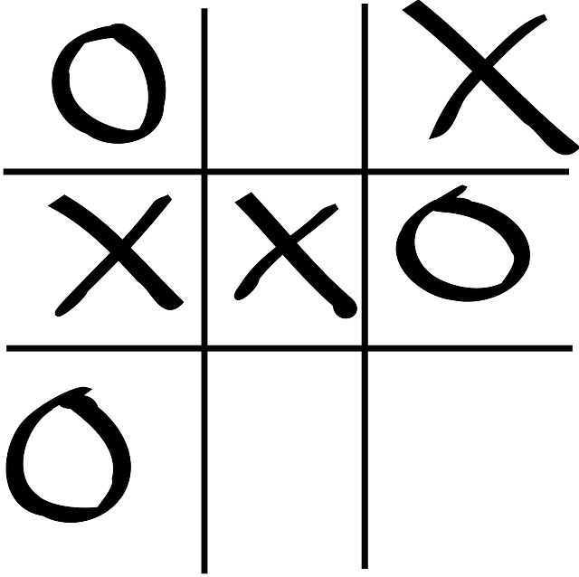
Well what makes up a game?
What do you think are some of the elements that make noughts and crosses a game?

Slide 9
Well what makes up a game?
Rules
Turns
Obstacles
Win state
Avatars / tokens
Players
Competition
http://pixabay.com/p-150614/?no_redirect

Slide 10
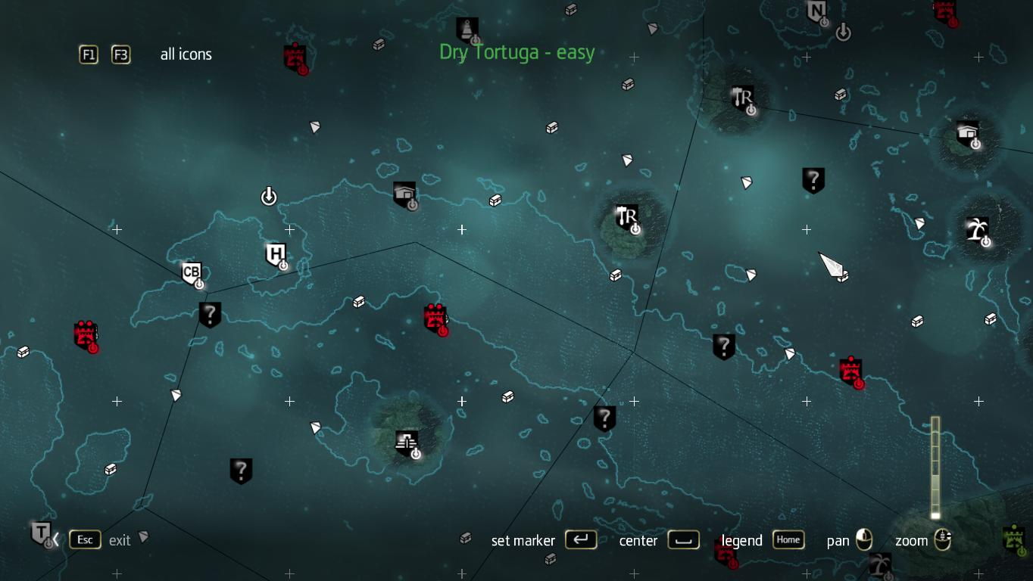
Well what makes up a game?
A range of tasks and missions to choose from

Slide 11
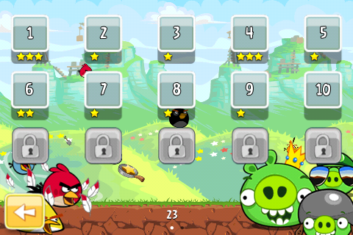
Well what makes up a game?
Feedback about how well we completed a task

Slide 12
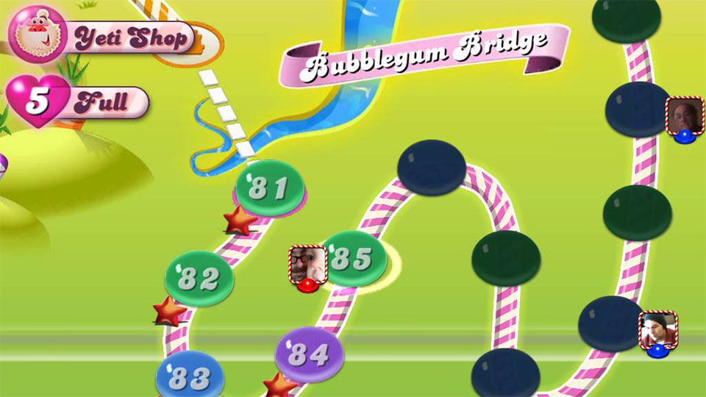
Well what makes up a game?
Information about how far we are through our quest

Slide 13
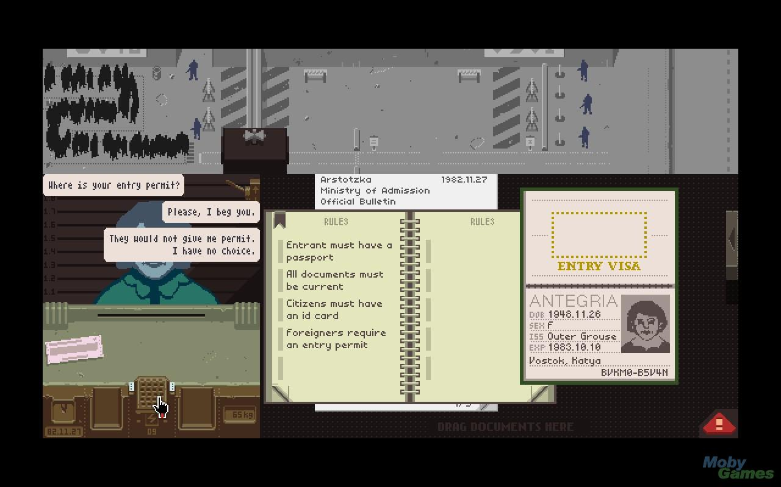
Well what makes up a game?
It could have a compelling story
http://www.mobygames.com/images/shots/l/649536-papers-please-windows-screenshot-her-husband-just-went-through.jpg

Slide 14
What might it look like in education?

Slide 15
What might it look like in education?

Slide 16
What might it look like in education?

Slide 17
What might it look like in education?

Slide 18
What might it look like in education?

Slide 19
What might it look like in education?

Slide 20
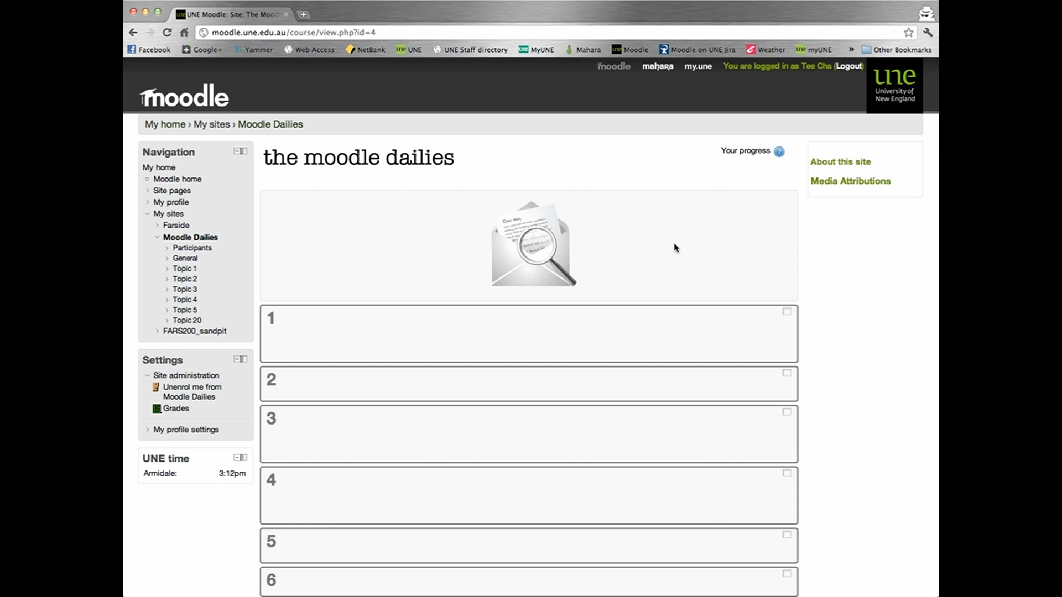
What might it look like in education?

Slide 21
What might it look like in education?

Slide 22
What might it look like in education?

Slide 23
So why gamify my course?
To create a deeper learning experience

Slide 24
So why gamify my course?
Flow (engagement)
“the state in which people are so involved in an activity that nothing else seems to matter”
(Mihaly Csikszentmihalyi 1990)

Slide 25
So why gamify my course?

Slide 26
So why gamify my course?
You might also know this as Vygotsky’s Zone of Proximal Development
Tomato, tomato.

Slide 27
So why gamify my course?
Fiero (Proud)

Slide 28
So why gamify my course?
Nicole Lazzaro has identified four types of fun:
Easy fun – blowing off steam, play, games without scoring

Slide 29
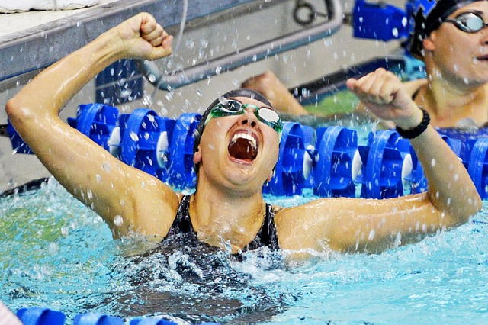
So why gamify my course?
Hard fun – challenges, mastery, overcoming obstacles

Slide 30
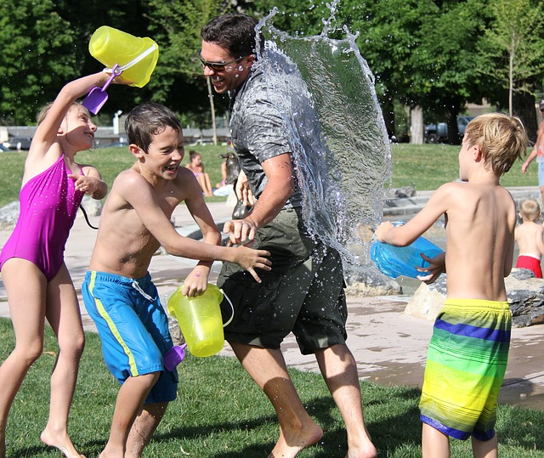
So why gamify my course?
People fun – the joy of interacting with others, working in a team

Slide 31
So why gamify my course?
Serious fun – doing things that are meaningful, good for the family/community/planet
http://upload.wikimedia.org/wikipedia/commons/3/39/FEMA_-_29748_-_Red_Cross_volunteer_and_shelteree_in_NJ,_photography_by_Andrea_Booher.jpg

Slide 32
So why gamify my course?

Slide 33
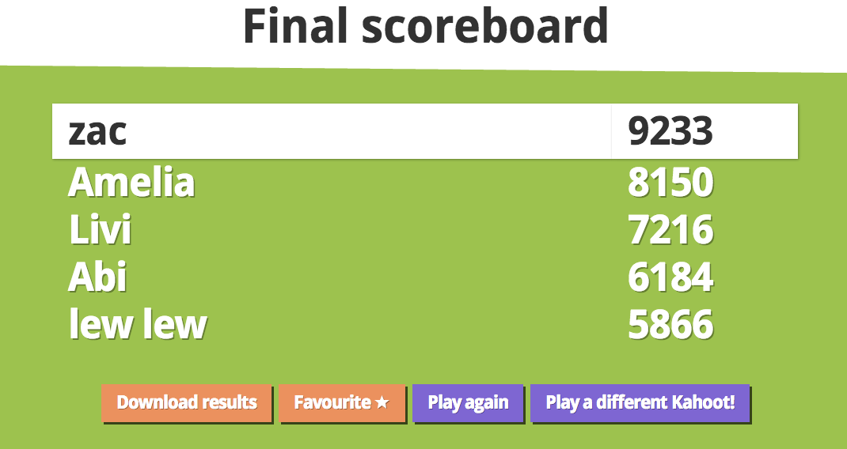
So why gamify my course?
Motivation – Extrinsic
Rewards from the outside
Gabe Zichermann (2011)
Status (leaderboards / competition)
http://4.bp.blogspot.com/-GdaVOKdjXU0/UnlbkSh1V0I/AAAAAAAAAEw/I9odD-2JSLg/s1600/Screen+Shot+2013-11-05+at+13.51.43.png

Slide 34
So why gamify my course?
Access (unlock new content)

Slide 35
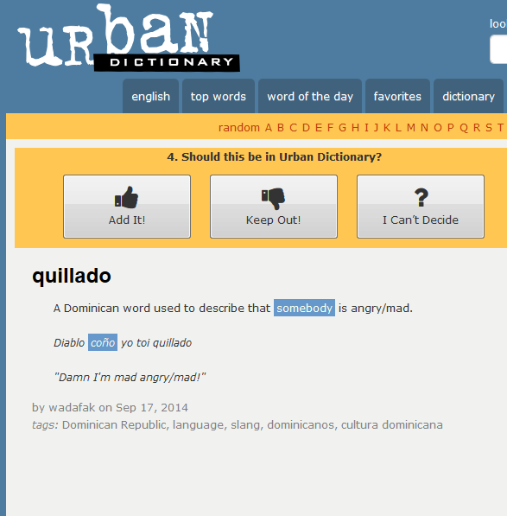
So why gamify my course?
Power (give new abilities)
(moderate content on a website)

Slide 36
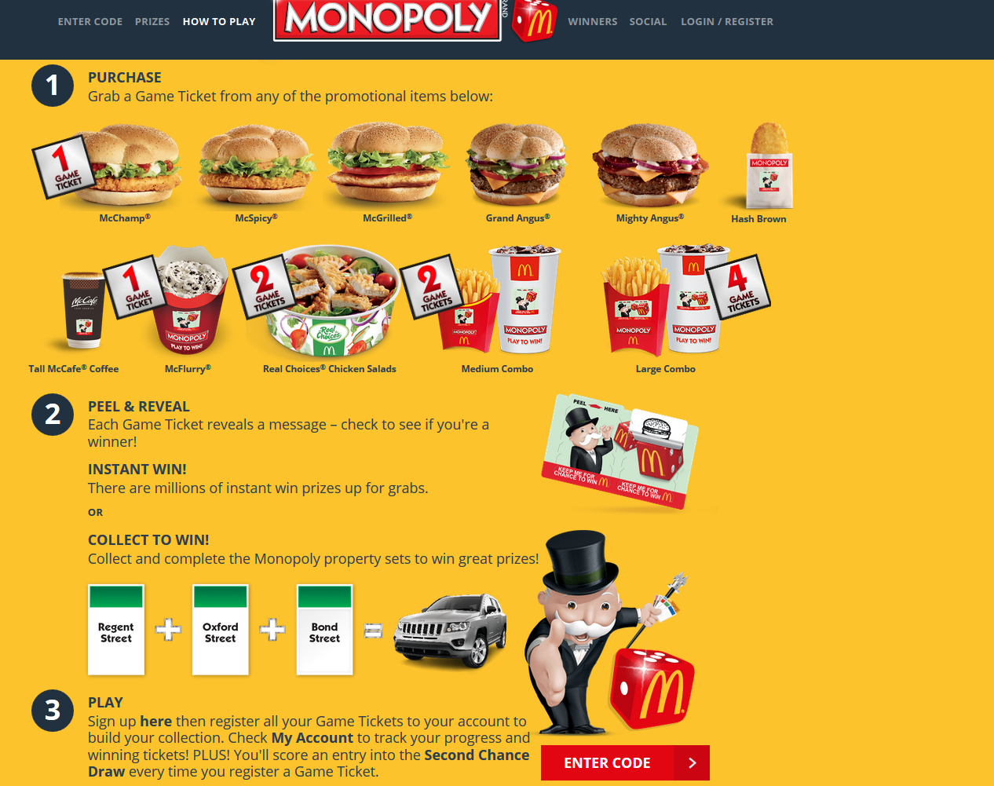
So why gamify my course?
Stuff (physical prizes)

Slide 37
So why gamify my course?
Motivation – Intrinsic
Internal drivers
Deci, Koestner & Ryan (2001)
“the issue is how to facilitate people’s understanding the importance of the activity to themselves… so they will be self motivated to perform it”

Slide 38
So why gamify my course?
Learners require: Autonomy – control of their learning path

Slide 39
So why gamify my course?
Competency – the ability to re-do assessments until they succeed
Games are all about learning by failing and trying again

Slide 40
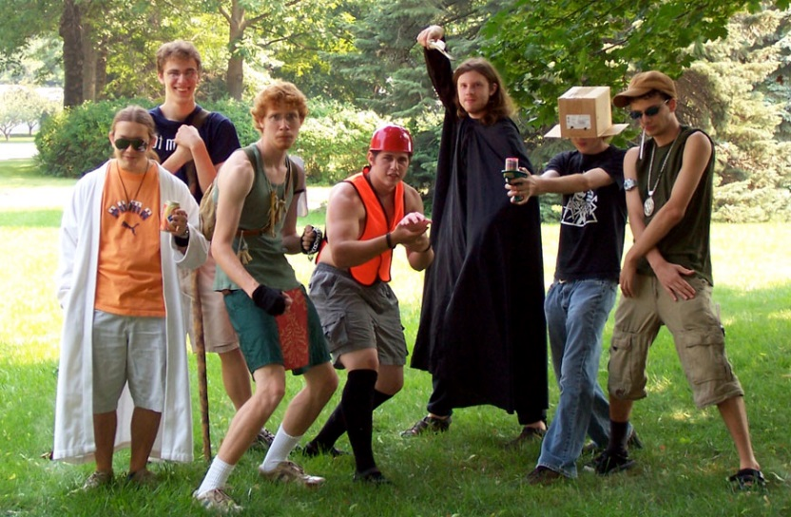
So why gamify my course?
Relatedness – ability to connect to other learners and the world, opportunities for collaboration
http://digitalcypher.com/random/larp.jpg

Slide 41
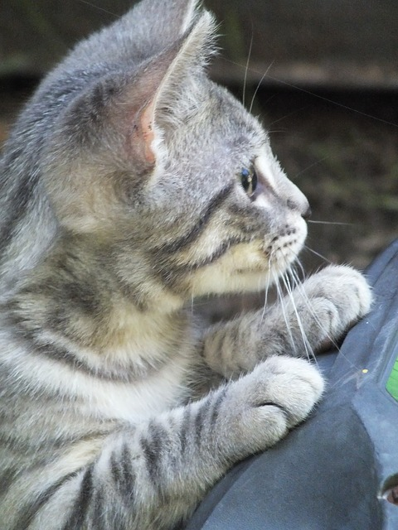
So why gamify my course?
Vockell (2008) identified 7 factors of intrinsic motivation
Challenge
Curiosity
Control
Fantasy
Competition
Collaboration
Recognition

Slide 42
So why gamify my course?
Nearly there
Malcolm Knowles (1970) identified six key factors relating to the motivating factors driving adult learners
Need to Know: Adults need to know the reason for learning something.
Foundation: Experience (including error) provides the basis for learning activities.
Self-Concept: Adults need to be responsible for their decisions on education; involvement in the planning and evaluation of their instruction.
Readiness: Adults are most interested in learning subjects having immediate relevance to their work and/or personal lives.
Orientation: Adult learning is problem-centered rather than content-oriented.
Motivation: Adults respond better to internal versus external motivators.

Slide 43
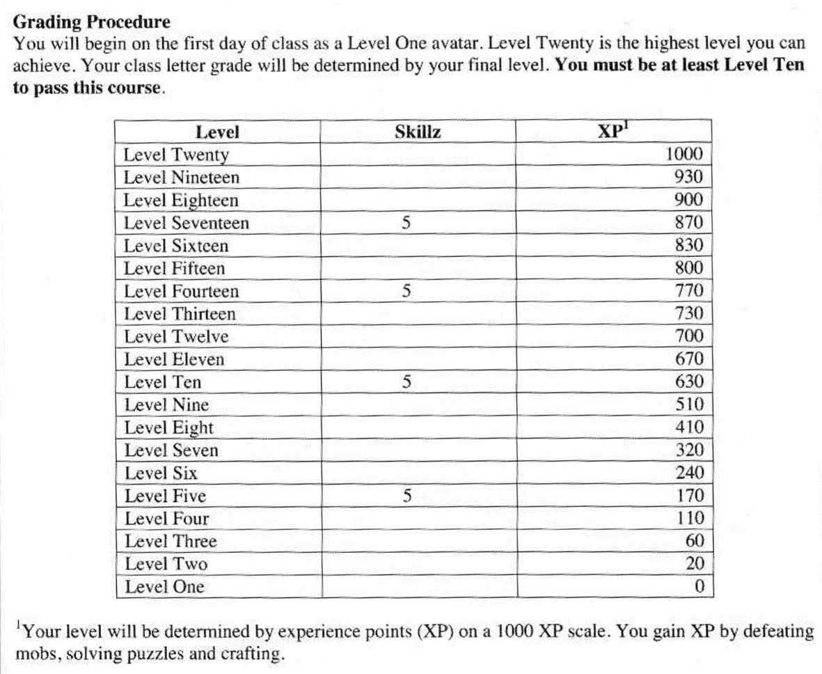
How to gamify your course
The Sheldon model

Slide 44
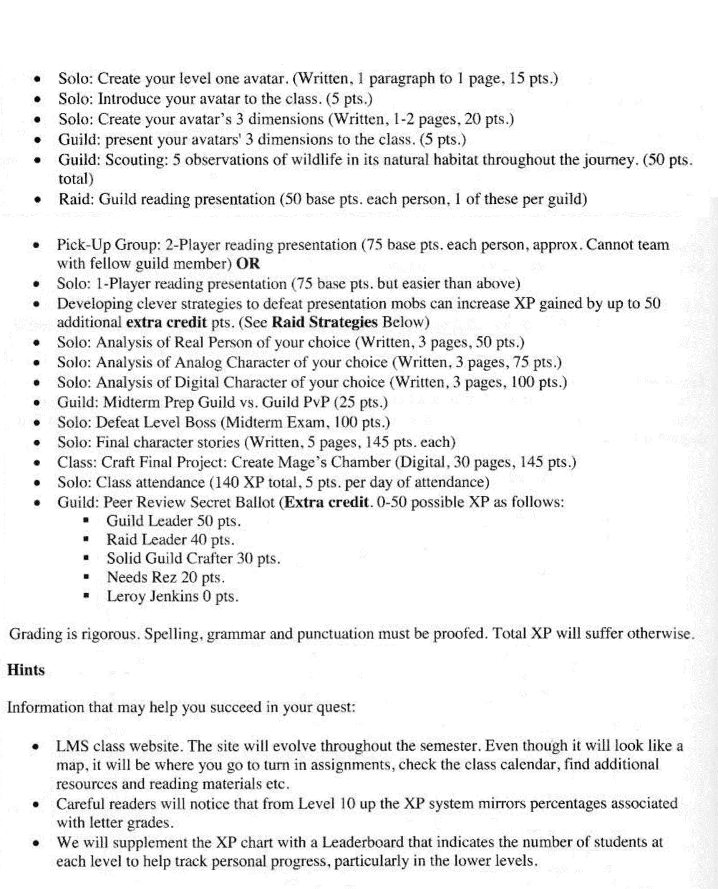
How to gamify your course
The Sheldon model

Slide 45
How to gamify your course
Bartle (1990) identified four main player types in multiplayer online games
http://frankcaron.com/Flogger/wp-content/uploads/2011/07/frankcaron_playerTypes_flat.png

Slide 46
How to gamify your course
Natalie Denmeade (@moodlemuse)
http://klevar.com/gamification-vs-games/

Slide 47
How to gamify your course
Natalie Denmeade (@moodlemuse)
http://bit.ly/mfm2013

Slide 48
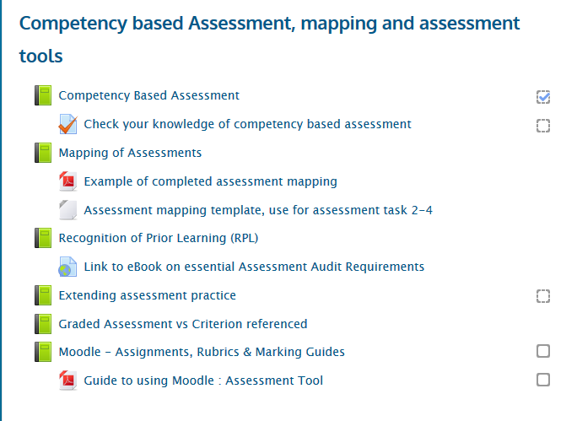
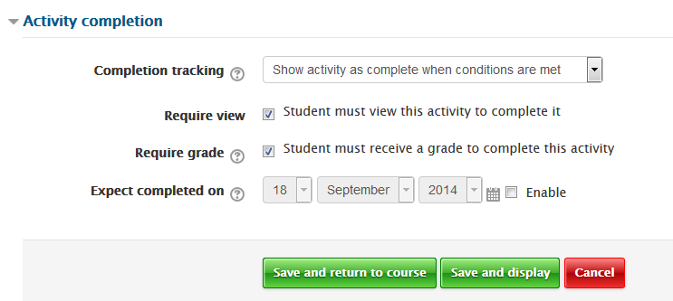
How to gamify your course
Progress
Completion Tracking

Slide 49
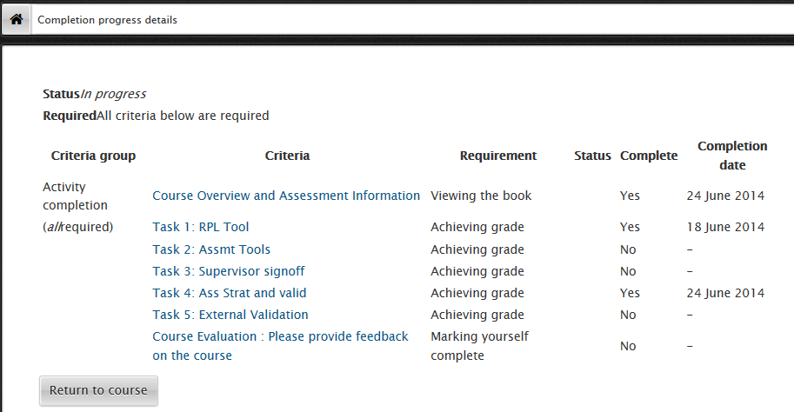
How to gamify your course
Progress
Course Completion Status block

Slide 50
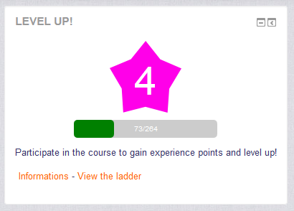
How to gamify your course
Progress
Level Up plugin

Slide 51
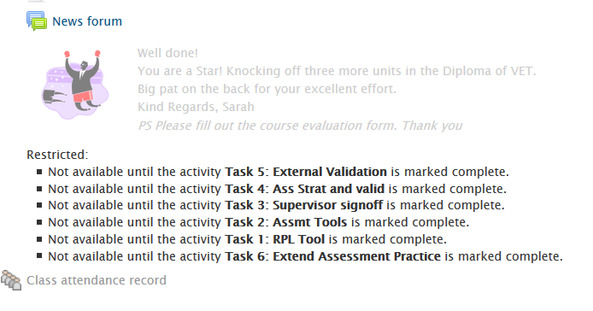
How to gamify your course
Progress
Restricted Access

Slide 52
How to gamify your course
Recognition
Badges*
*Badges can be generated directly in Moodle (Wattle) but not displayed outside the online course.
There may be other institutional barriers to the use of Badges.

Slide 53
How to gamify your course
Recognition
Peer designed and awarded Badges or Achievements

Slide 54
How to gamify your course
Recognition
Points and leaderboards
Some ideas:
Allocate points for contributions to class – face to face or online.
List only the top three – five students each week.
Reset the list at the end of the week so that everyone has a chance.
Offer points for a range of activity types suiting different strengths
Opt in system
Students could use avatar names instead of their own
Can be as simple as embedding a spreadsheet in your course

Slide 55
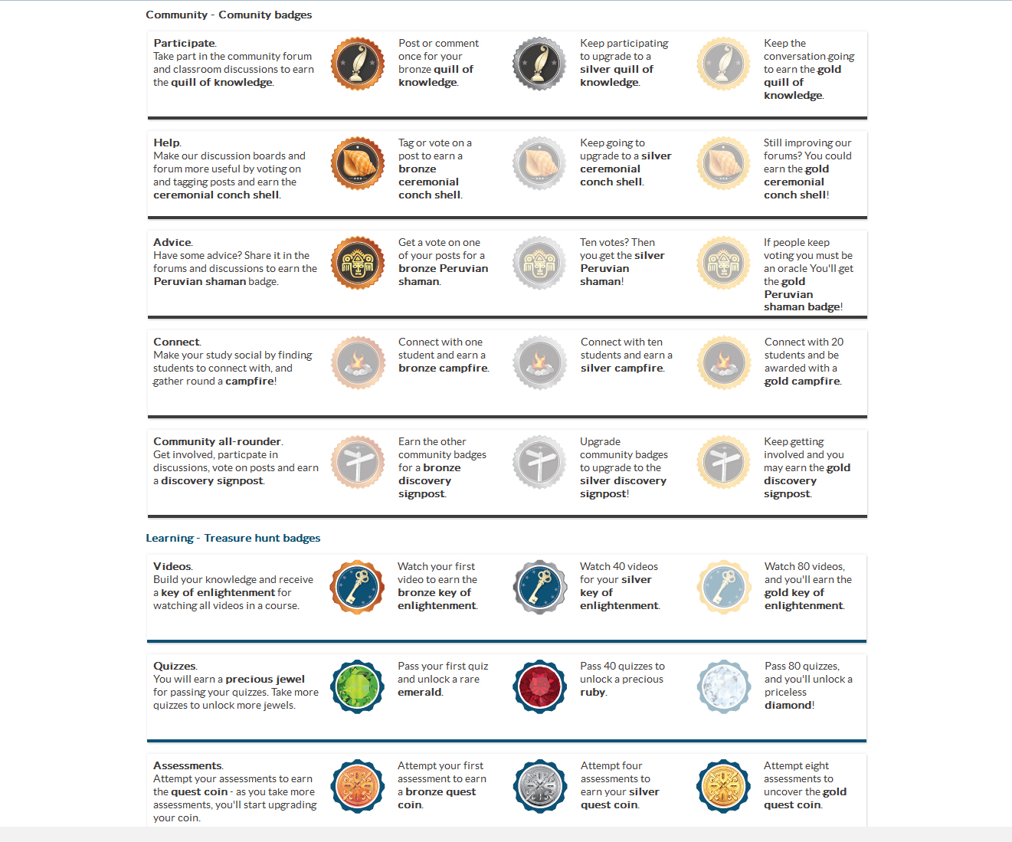
How to gamify your course
Progress
Badges and Pathways

Slide 56
How to gamify your course
Autonomy
Pathways
What if learners could choose their assessment types?
What if they could choose the level of achievement that they are happy with?

Slide 57
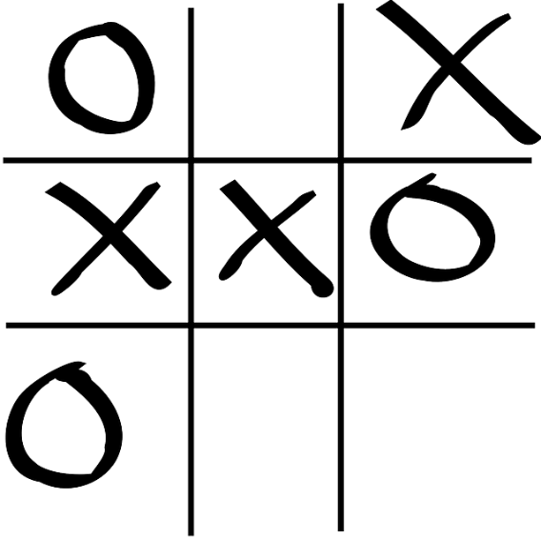
How to gamify your course
Miscellaneous ideas
Get students to name and design avatars for the course.
(These could even be paper based)
As they complete certain tasks or make particular achievements, they earn costume pieces or equipment for their avatar, which are on display. (fun / progress / relevance / recognition / competition)
Frame learning outcomes as a series of puzzles with a course long narrative – engage the students in designing the story that they will “play”
Allow “farming” of extra credit via glossary or link contributions.

Slide 58
How to gamify your course
Shall we play a quick game?
Further notes, references and links available on
http://www.screenface.net/gamification
Feel free to chat to me via @gamerlearner or colin.simpson@cit.edu.au

